Slide 1




Beyond Clicks & Prompts: Designing for Human-AI Interaction (HAII)
Eleftheria Batsou
@BatsouElef
@eleftheriabatsou
@eleftheriabatsou
Developer Advocate @cosineai
Notes:
Titles: A .“Beyond Clicks & Prompts: Designing for Human-AI Interaction (HAII)” B. “From Buttons to Black Boxes: Why Human-AI Interaction Matters”
C.“Coding Beyond HCI: Designing for Human-AI Interaction”
D.“Developers & AI: Building Trust, Control, and Explainability” --- ✨ From Buttons to Black Boxes: Why Human-AI Interaction Matters
AI is no longer a “nice-to-have” feature—it’s becoming part of every developer’s toolkit. But designing interactions with AI isn’t the same as designing a button or a form. Unlike traditional Human-Computer Interaction (HCI), Human-AI Interaction (HAII) is probabilistic, dynamic, and sometimes unpredictable.
In this talk, we’ll explore:
The key differences between HCI and HAII (and why devs should care).
The main challenges of building AI-powered products: explainability, trust, and user control.
Real-world examples (like Gemini and cosine.sh) that show how good design can make or break user trust.
Practical takeaways you can use when building AI features—so your users stay in control and keep coming back.
By the end, you’ll understand how to go beyond just writing code for AI and start designing collaboration between humans and AI.

Slide 2
What is HCI?
HCI = Human Computer Interaction
Traditional interaction between humans and computers.
Predictable, predefined, rule-based.
X: @BatsouElef LI, IG: @eleftheriabatsou
Notes:
In HCI, interactions are largely predefined and predictable. When a user clicks a button, they know what action it will trigger, where it will lead them, and what outcome to expect

Slide 3
What is HAII?
HAAI = Human-AI Interaction
Interaction with AI-driven systems.
Dynamic, adaptive, probabilistic, co-created with users.
The relationship between humans and AI is far more complex than that between humans and traditional computers.
X: @BatsouElef LI, IG: @eleftheriabatsou
Notes:
Designing Human-AI interactive products is far more complex and impactful than traditional design. While a poorly designed UX in a conventional product may sometimes be overlooked if the core functionality is intact, a flawed Human-AI interaction design can leave users completely lost, unable to understand what is happening or how to navigate the digital product. In such cases, the risk of losing user trust and usability is significantly high.

Slide 4
Key Differences & Example
HCI: Predictable, Static, Predefined
HAII: Probabilistic, Dynamic, Co-created
Example: In an AI-driven system, a user inputs a prompt or selects from a range of available options. However, the outcome is not always predictable, as AI responses are dynamic and shaped by various factors, such as the:
input given,
the AI’s training data,
and its probabilistic nature.
X: @BatsouElef LI, IG: @eleftheriabatsou

Slide 5
AI Isn’t Just Another Tool
It changes how humans and machines collaborate.
Developers must design for trust, clarity, and control.
✓ AI tools are rapidly integrated into daily life and digital products.
✓ Poor Human-AI design risks leaving users confused and losing trust.
✓ Unlike traditional UX, Human-AI interaction is complex, dynamic, and critical to get right.
X: @BatsouElef LI, IG: @eleftheriabatsou
Notes:
Designing Human-AI interactive products is far more complex and impactful than traditional design. While a poorly designed UX in a conventional product may sometimes be overlooked if the core functionality is intact, a flawed Human-AI interaction design can leave users completely lost, unable to understand what is happening or how to navigate the digital product. In such cases, the risk of losing user trust and usability is significantly high.
---
To summarize, traditional human-computer interaction is characterized by clear, definitive outcomes, fixed processes, and static outputs. In contrast, human-AI interaction involves dynamic, variable, and probabilistic results. From a design perspective, traditional HCI focuses on guiding users within a structured system where content and interactions are predefined. In HAII, however, content is not fixed—rather, it is co-created by the user and the AI through collaboration. This shift from a rigid, rule-based interaction model to an open-ended, adaptive experience is one of the fundamental differences between the two approaches. page 5

Slide 6
Key Challenges in HAII
1/3. Explainability: Why Did the AI Do This?
As users, we must be able to understand how the AI arrived at a particular result, why it provided that response, and how we can influence or adjust the outcome if needed.
AI system
User’s Input
Processing Phase
Output
Based on the: AI’s knowledge, training data, and learned patterns
Notes:
In Human-AI interaction, every input provided by the user goes through a processing phase within the AI system. This process analyzes the input based on the AI’s knowledge, training data, and learned patterns, ultimately generating an output. As users, we must be able to understand how the AI arrived at a particular result, why it provided that response, and how we can influence or adjust the outcome if needed. Sold to 5 gokbey.inac@things.ist This is where the “black box” effect of AI systems becomes a major issue. If the AI cannot explain why or how it produced a particular output, users are left with no clear understanding of the reasoning behind the result. This lack of transparency creates frustration, as users are unable to determine what went wrong when the system produces an unexpected or undesired outcome.

Slide 7
Key Challenges in HAII
1/3. Explainability: Why Did the AI Do This?
This is where the “black box” effect of AI systems becomes a major issue.
If the AI cannot explain why or how it produced a particular output, users are left with no clear understanding of the reasoning behind the result.
This lack of transparency creates frustration, as users are unable to determine what went wrong when the system produces an unexpected or undesired outcome. 🫤
X: @BatsouElef LI, IG: @eleftheriabatsou
Notes:
In Human-AI interaction, every input provided by the user goes through a processing phase within the AI system. This process analyzes the input based on the AI’s knowledge, training data, and learned patterns, ultimately generating an output. As users, we must be able to understand how the AI arrived at a particular result, why it provided that response, and how we can influence or adjust the outcome if needed. Sold to 5 gokbey.inac@things.ist This is where the “black box” effect of AI systems becomes a major issue. If the AI cannot explain why or how it produced a particular output, users are left with no clear understanding of the reasoning behind the result. This lack of transparency creates frustration, as users are unable to determine what went wrong when the system produces an unexpected or undesired outcome.

Slide 8
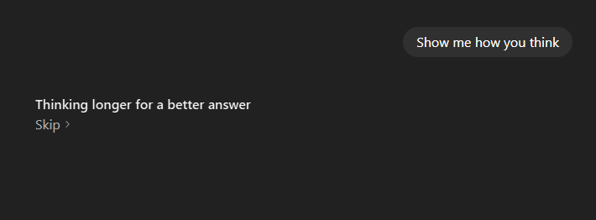
Example: Explainability ✅
“Show me how you think.” ChatGPT
1.First, the term “Thinking” is visibly displayed
The “Thinking” indicator functions similarly to traditional UX system status indicators, informing the user of the system’s current activity. This ensures that the user understands what is happening and at which stage the process is.
X: @BatsouElef LI, IG: @eleftheriabatsou

Slide 9
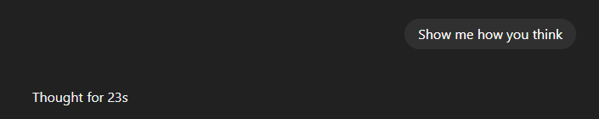
Example: Explainability ✅
“Show me how you think.” ChatGPT
2. Secondly, shows that thought process is ongoing
After the process is completed, we see that there was a 23-second thinking phase.
X: @BatsouElef LI, IG: @eleftheriabatsou

Slide 10
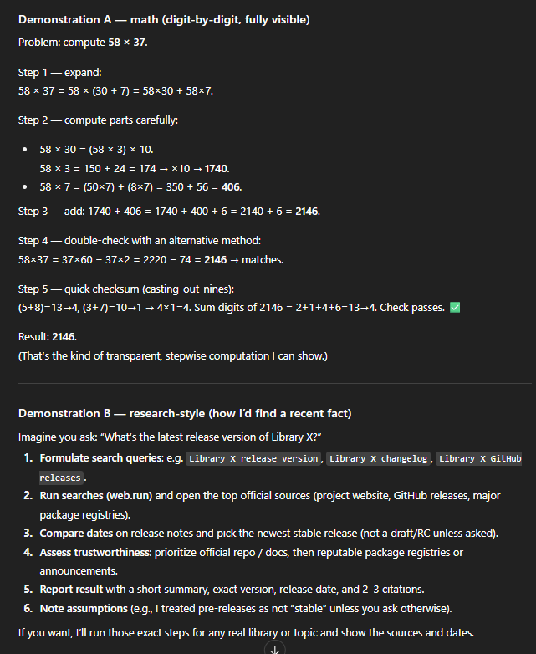
Example: Explainability ✅
“Show me how you think.” ChatGPT
3. Thirdly, the response
The system explains the rationale behind its answer, providing users with insight into how it arrived at the response.
X: @BatsouElef LI, IG: @eleftheriabatsou

Slide 11
Key Challenges in HAII
1/3. Explainability: Why Did the AI Do This?
2/3. Trust: Is the AI Providing Accurate Information?
User trust is one of the fundamental elements in the interaction between humans and AI. This is because the nature of this interaction is not just about receiving responses—it is about fostering collaboration between humans and AI to accomplish tasks together. 🤝
For this collaboration to be effective, the AI’s outputs must be reliable, meaning that the responses generated based on user prompts and selections should be accurate, consistent, and trustworthy.
X: @BatsouElef LI, IG: @eleftheriabatsou

Slide 12
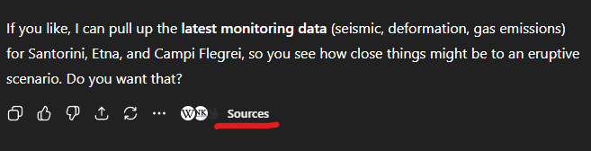
Example: Trust✅
Designing for Trust: How to Present Reliable AI Outputs
“Provide me with information about volcanic activity in Greece and Italy.” ChatGPT
X: @BatsouElef LI, IG: @eleftheriabatsou
Notes:
To enhance the perceived reliability of AI-generated outputs, sources and references must be visually distinct from the main content and presented in a way that is clear and easily recognizable to users.
For instance:
• If a web page is cited, use an icon and a hyperlink to indicate that it is a clickable reference.
• If a documented source is provided, position it separately from the AI-generated content to reinforce credibility.

Slide 13

Example: Trust✅
The system lists the sources on which it bases its argument, providing additional transparency.
When you click on “Sources,” you gain direct access to the links of the referenced materials, allowing users to verify the information independently.
X: @BatsouElef LI, IG: @eleftheriabatsou
Notes:
Of course, there is still room for improvement in this design. While users can access content sources, it may be beneficial to highlight these references more prominently within a text-based output or even assign a confidence score to each source. The ultimate goal here is to build trust in the information presented to the user, and this should always remain a key priority.

Slide 14
Key Challenges in HAII
1/3. Explainability: Why Did the AI Do This?
2/3. Trust: Is the AI Providing Accurate Information?
3/3. User Control: What Is the AI Doing Right Now?
The more detailed and contextually enriched a user’s prompt or request is, the higher the likelihood of receiving a successful output.
AI system
Autonomous
They can perform tasks independently without human intervention
X: @BatsouElef LI, IG: @eleftheriabatsou
Notes:
To summarize, traditional human-computer interaction is characterized by clear, definitive outcomes, fixed processes, and static outputs. In contrast, human-AI interaction involves dynamic, variable, and probabilistic results. From a design perspective, traditional HCI focuses on guiding users within a structured system where content and interactions are predefined. In HAII, however, content is not fixed—rather, it is co-created by the user and the AI through collaboration. This shift from a rigid, rule-based interaction model to an open-ended, adaptive experience is one of the fundamental differences between the two approaches. page 5

Slide 15
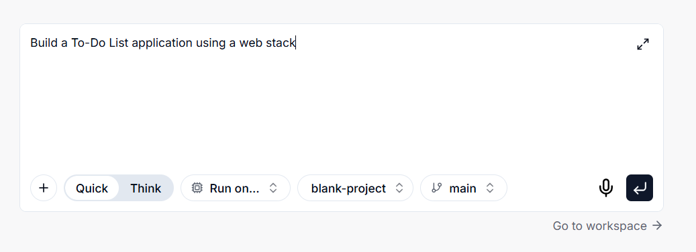
Example: User Control ✅
“Build a To-Do List application using a web stack.” Cosine.sh
AI Code Editors:
Quick or Think Mode
Run on: Cloud, Locally, CLI
Insert a file/upload an image
X: @BatsouElef LI, IG: @eleftheriabatsou
Notes:
To give users more control over the development process and improve the effectiveness of their prompts, AI code editors have introduced several features. (right column)

Slide 16
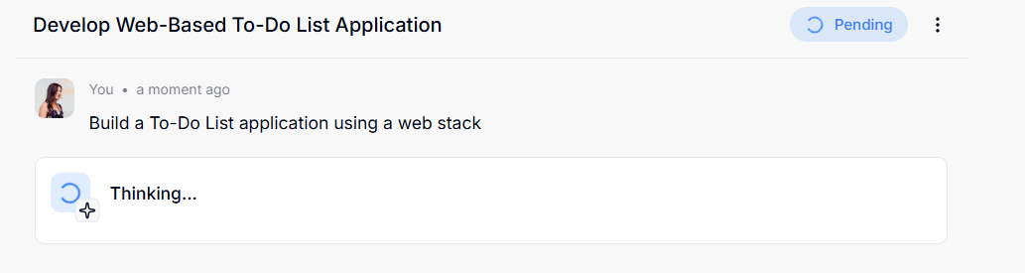
Example: User Control ✅
“Build a To-Do List application using a web stack.” Cosine.sh
AI Code Editors:
Thinking / Pending
X: @BatsouElef LI, IG: @eleftheriabatsou

Slide 17

Example: User Control ✅
AI Code Editors:
Thinking / Pending

Slide 18
What Can You Do?!
Explainability: AI showing reasoning → status indicators, thought process, transparency.
Trust: Problem → hallucinations Solution → clear references, citations, confidence indicators.
User Control:
Developers, Users need visibility & rollback.
Solution → Checkpoints, version history, step-by-step AI actions.
X: @BatsouElef LI, IG: @eleftheriabatsou

Slide 19
What Happens If You Don’t Act?!
Lack of Explainability → Debugging hell
Poor Trust → Risk of shipping unreliable features
Lack of User Control → Wasted hours fixing AI-generated mess
X: @BatsouElef LI, IG: @eleftheriabatsou

Slide 20
Why It Matters for Developers
✓ Well-designed HAII = less user frustration & higher trust in your product.
✓ Clearer AI interaction = easier debugging, fewer support headaches.
✓ Good UX in AI = better adoption & happier users (they’ll keep using what you build).
X: @BatsouElef LI, IG: @eleftheriabatsou
Notes:
Page 18–19: Solving usability issues, confidence scores, transparency.
Page 28: Final Notes — stresses the importance of HAII vs. traditional UX and its future relevance.

Slide 21
Summary
Developers play a key role in making AI outputs usable & trustworthy.
HAII is not just a design challenge, it’s a dev challenge.
If you’re building with AI, you’re also shaping how humans trust and use it.
As devs, we’re not just coding for machines—we’re coding for collaboration.
X: @BatsouElef LI, IG: @eleftheriabatsou
Notes:
The way we approach human-AI interaction is fundamentally different from traditional UX design principles and human-computer interaction models. As AI systems continue to evolve, this topic will become even more critical, and I expect discussions around it to grow significantly in the near future. I hope this guide proves valuable to you.
Mostly from the Final Notes on page 28

Slide 22
Thank You
Takeaway:
Think beyond the code → design the collaboration.
👩‍💻 Questions?
X: @BatsouElef LI, IG: @eleftheriabatsou
Notes:
The way we approach human-AI interaction is fundamentally different from traditional UX design principles and human-computer interaction models. As AI systems continue to evolve, this topic will become even more critical, and I expect discussions around it to grow significantly in the near future. I hope this guide proves valuable to you.
Mostly from the Final Notes on page 28

