Slide 1
End-to-End Coverage with Playwright and Istanbul
John Pourdanis, Lead Software QA @Vimachem

Slide 2
Who is talking?
Over 12 years of experience in Software Industry
Co-Organizer of Thessaloniki Software QA Meetup
Proud dad
Software Testing Trainer
Professional Nothing Knower

Slide 3
The Challenge
We write comprehensive End-to-End (E2E) tests with powerful tools like Playwright.
These tests simulate real user journeys, validating critical application flows.
But how much code do these E2E tests actually execute?

Slide 4
The Questions
Are our E2E tests truly exercising the core business logic?
Are there critical paths in the UI that are never touched by E2E tests?
Are we over-testing some areas and under-testing others?

Slide 5
What is E2E Code Coverage
Definition:
End-to-End Code Coverage measures the percentage of your application's source code that is executed when your E2E test suite runs.
It provides insights into which lines, branches, functions, and statements are hit during a full user interaction flow.

Slide 6
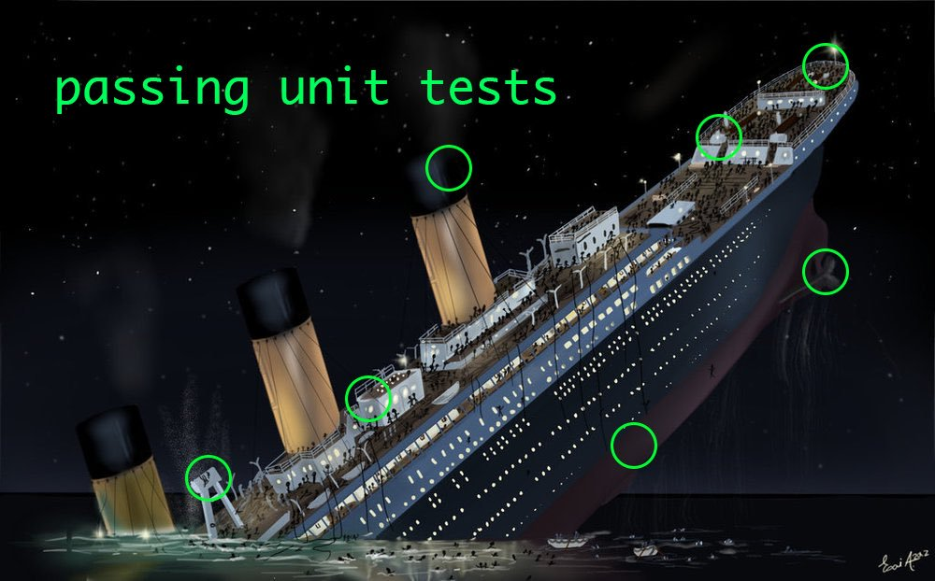
But we have unit tests, are not enough?

Slide 7
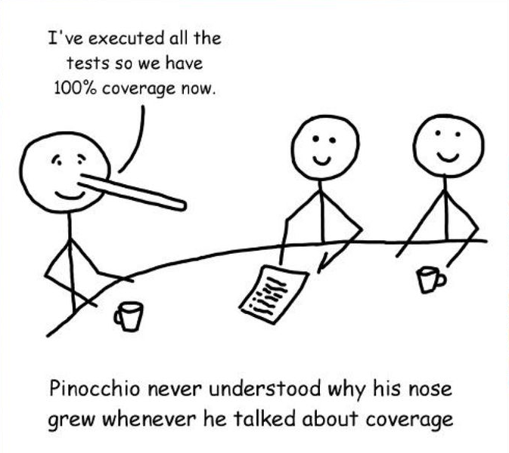
100% coverage is a myth

Slide 8
Playwright - A Modern E2E Testing Framework
Supports multiple browsers (Chromium, Firefox, WebKit)
Enables UI automation and API testing
Works with JavaScript, TypeScript, Python, and more
Integrates well with Istanbul for coverage reporting

Slide 9
Istanbul aka Constantinople - Code Coverage for JavaScript
Tracks test execution within applications
Uses instrumentation to inject coverage tracking
Works with React/Angular/Vue applications via Babel
Generates detailed reports on untested code

Slide 10
How Istanbul Injects Coverage into a React App
Uses babel-plugin-istanbul to modify React build
Inserts tracking code into source files
Listens for page unload events
Tracks executed lines, functions, and branches
Data is stored in the __coverage__ global object

Slide 11
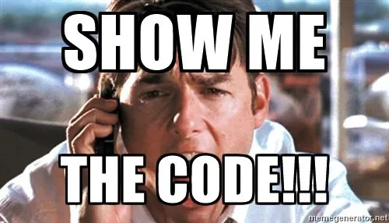
Demo time!

Slide 12
Final Thoughts
End-to-end test coverage is a metric that can proof that e2e tests actual cover the functionality from code perspective.
Instrumentation of the code is the key.
We won’t try to achieve 100%
Coverage is a metric, not a guarantee of quality.

Slide 13

Q&A for QA
Thank you for your time!
Happy to connect with everyone.

