Slide 1


The evolution of Web Rendering Architectures
From Static HTML to Hybrid Architectures
Evangelia Mitsopoulou, Founder @Evangelia
Thessaloniki, 05.12.24

Slide 2
Agenda
Key Aspects of Rendering Architectures
Evolution of Rendering Architectures
Current trends & Hybrid Rendering Solutions
Future Directions of Rendering Architectures

Slide 3
Key Aspects of Rendering Architectures
Programming Model: Imperative vs Declarative
Primitive Language: Javascript vs Web Assembly
Location of Rendering: Client vs Server
Reactivity Type: Fullpage Reload vs Hydration vs Resumability vs Islands
Performance: Web Vitals

Slide 4
Understanding Imperative vs. Declarative Approaches
HOW?
WHAT?
to create the desired outcome
is the desired outcome
Imperative
Declarative

Slide 5
Understanding Imperative vs. Declarative Approaches
Instruct browser how to create the UI
Add data on the what (template) of UI
const list = document.getElementById("list");
const items = ['Item 1', 'Item 2', 'Item 3'];
// Imperatively append items to the list
items.forEach(item => {
const li = document.createElement('li');
li.textContent = item;
list.appendChild(li);
});
function ItemList({ items }) {
return (
<ul>
{items.map(item => (
<li key={item}>{item}</li>
))}
</ul>
);
}
const items = ['Item 1', 'Item 2', 'Item 3'];
ReactDOM.render(<ItemList items={items} />, document.getElementById('root'));
Imperative
FRONTEND
Declarative
Notes:
Declarative: You simply declare what the UI should look like. You describe a list of items. React manages the how (rendering, updating DOM)
Imperative:

Slide 6
Understanding Imperative vs. Declarative Approaches
Instruct browser how to create the UI
Add data on the what (template) of UI
<html>
<head>
<title> Welcome </title>
</head>
<body>
<?php echo “<h1> Hello, $user_name!<h1>”;?>
</body>
</html>
<html>
<head>
<title> Welcome </title>
</head>
<body>
<h1> Hello, {$user_name}!<h1>
</body>
</html>
Imperative
BACKEND
Declarative
Notes:
Declarative: You simply declare what the UI should look like. You describe a list of items. React manages the how (rendering, updating DOM)
Imperative:

Slide 7
Locations of Rendering
Location | Pros | Cons
Client | Reduced server load, Dynamic user experiences | Slow initial load, SEO Challenges
Server | Fast initial load, better SEO | Increased server load, Slower interactivity
Hybrid | Optimized for SEO and dynamic user experiences | Complexity in integration & hydration
Notes:
Client:
The browser downloads HTML, CSS, and JavaScript, then renders the page using JavaScript (React, Vue, etc.).
Server:
The server generates the complete HTML page and sends it to the client.
Hybrid:
The initial render happens on the server (SSR), then the client takes over for further interactivity (CSR).

Slide 8
Primitive Language
Javascript/Typescript: Most interactions
Web Assembly: Low-level interactivity, for performance heavy tasks
Interactivity
Layout & Aesthetics
HTML: Structure and layout
CSS: Formatting and slight interactivity with animations

Slide 9
Reactivity
Definition: Defines how and when UI updates in response to user interactions or state changes
Reactivity Types:
  Full-page Reload
  Hydration
  Resumability
  Islands Architecture
  Static Cached

Slide 10
Web Vitals
Largest Contentful Paint (LCP): The render time of the largest image, text or video visible in the viewport
Interaction to Next Paint (INP): Page responsiveness to user interactions by observing the latency of all click, tap and keyboard interactions.
Cumulative Layout Shift (CLS): Measures visual stability or the number of unexpected layout shifts that occur during user interactions i.e. elements appearing, resizing, or repositioning.

Slide 11
What architectural waves have emerged over the time based on the key aspects?

Slide 12
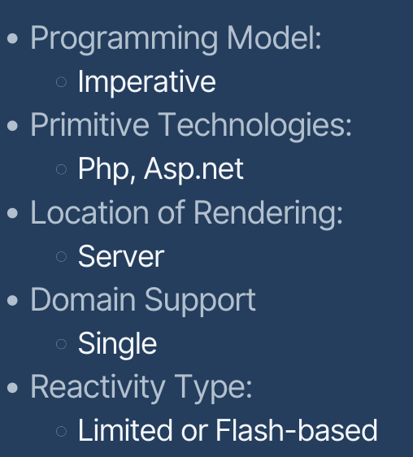

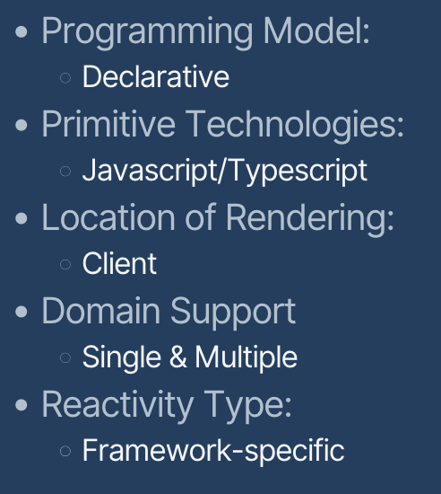
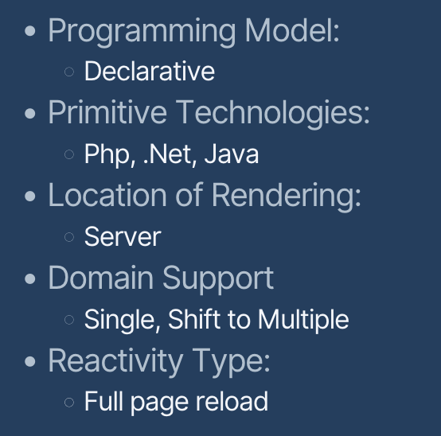
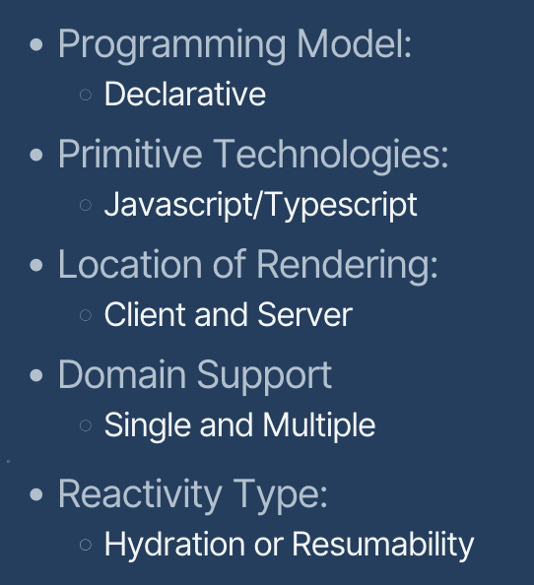
Historical Evolution of Web Rendering Architectures
1990s
Static Server Content
Dynamic Server Rendering
2000-2010
2010-2020
Dynamic Client Rendering
2020s
Hybrid Client & Server Rendering
Notes:
To ADD the diagrams

Slide 13



Web Rendering in 1990s
CLIENT
Source Code (Static HTML)
Browser View
STATIC HTML
SERVER
Reads html file from file system
Serves source html file to client
File System

Slide 14


Web Rendering in 2000-2010
CLIENT
Add interactivity to
Static HTML
Browser View
jQuery, ES6 Modules
HTML Source Code
Placeholders have been replaced by their values
HTML with dynamic content
SERVER
Retrieval of dynamic DB values
Further computations of values
Placement of computed values as
Variables-placeholders at template-engine
Database

Slide 15
Diagram Historical Evolution 2010-2020
CLIENT
JSON data Retrieval
+
=
DOM Update
Template Engine
HTML Source Code
A single bundled js file
Virtual DOM Creation
Reconciliation
JSON
SERVER
Retrieval of dynamic DB values
Perform various business logic on the above values
Serve in JSON the computed response
Database

Slide 16
Current trends & Hybrid Rendering Solutions
Hybrid Approaches combining SSR, CSR, RSC, SSG, ISG.
Granularity in Rendering (Islands Architecture): focusing hydration of specific components
Resumability: avoid hydration altogether by resuming from server-rendered state
Notes:
https://dev.to/jenhsuan/day-32-of-100daysofcode-the-difference-between-csr-ssr-pre-rendering-and-static-ssr-1f49
Compare ssr vs csr vs ssg vs pre-rendering

Slide 17
React Server Components (RSC)
React Server Components (RSC): React’s feature that allows components to run on the server and send lightweight html/json to the client without any javascript.
  Render on server at runtime
  Non-interactive
  Combine seamlessly with client components

Slide 18
Server Side Rendering (SSR)
Server Side Rendering (SSR): Generates HTML on the server for every request, delivering dynamic pages with pre-rendered content.
Used in Nextjs, Nuxtjs, Ruby on Rails
Best Use Case: E-commerce, dashboards or pages requiring dynamic content and personalization

Slide 19
Client Side Rendering (CSR)
Client Side Rendering (CSR): The Browser fetches a minimal HTML shell and renders content dynamically using Javascript.
Used in SPAs with frameworks like Angular, Vue, React
Best Use Case: Highly interactive applications where dynamic updates dominate
Notes:
TTFB: Time to First Byte - seen as the time between clicking a link and the first bit of content coming in.
FCP: First Contentful Paint - the time when requested content (article body, etc) becomes visible.
TTI: Time To Interactive - the time at which a page becomes interactive (events wired up, etc).
All logic, data fetching, templating and routing are handled on the client rather than the server.
Ways to improve performance:
Aggressive code-splitting
Pre-rendering
PRPL pattern
Preload the late-discovered resources
Render the initial route as soon as possible
Pre-cache remaining assets (e.g., service worker)
Lazy load other routes and non-critical assets
There are two types of hydrations.
Destructive hydration: destroy the DOM tree and reload it when rendering on the browser (has flickering issue)
Non-destructive hydration: instead of destroying, the DOM tree will be leveraged on the client side

Slide 20
Static Site Generation (SSG)
Static Side Generation (SSG): Pre-renders pages at build time, generating static HTML files that can be served directly by a CDN
Used by frameworks like Next.js, Astro, Hugo, Gatsby
Best Use Case: Blogs, documentation stites or any other static content

Slide 21
Incremental Static Generation (ISG)
Incremental Static Generation (ISG): A hybrid approach where static pages are pre-rendered during on demand and cached for future-requests
  Next.js specific
Best use case: Large content-heavy sites (e.g., e-commerce with thousands of product pages)

Slide 22
Hybrid Solutions (SSR + CSR + Hydration)
CLIENT
Static HTML for client & server components
Hydrated HTML with js
HTML
JS
SERVER
client component
server component
server component
client component

Slide 23
Islands Architectures (partial/selective hydration)
Definition: A rendering strategy where only specific “islands” (interactive components) on the page are hydrated while the rest remains static HTML.
How it works:
  The server pre-renders the static parts and isolates interactive parts as “islands”
  Each island is hydrated independently, avoiding unnecessary Javascript execution
Use case: Content-heavy sites with isolated interactive components

Slide 24
Islands Architecture
CLIENT
Static HTML + Uninteractive Interactable Components
Static HTML
+
Hydrated interactive components
HTML
JS
SERVER
static HTML
Interactable component
Interactable component
Static HTML

Slide 25
Resumability
Definition: A new paradigm in rendering where client resumes execution from the server-rendered state without requiring hydration
How it works:
  Server renders the page and sends it to the client along the application state
  The client directly resumes the application state without initializing or executing redundant Javascript

Slide 26
Resumability
CLIENT
HTML with references to event handlers in the format
data-q:event = “increment:1”
Service Workers
hashed1.js
increment handler → 1 (chunk ID) → chunk-1.js.
or
hashed2.js
Main Thread
hashed3js
Storage of chunks
Javascript Chunk Mapping
HTML + hashed unexecuted js chunks
SERVER
static component
interactive component
interactive component
static component

Slide 27
Resumability Example
// Qwik Component Example
import { component$ } from '@builder.io/qwik';
export const Counter = component$(() => {
let count = 0;
// Event handler embedded in the server-rendered HTML
const increment = () => {
count += 1;
console.log(count);
};
return (
<div>
<button onClick$={increment}>Increment</button>
<span>{count}</span>
</div>
);
});
<!-- Server-rendered HTML with event handlers embedded -->
<div>
<button data-q:event="increment:1">Increment</button>
<span>0</span>
</div>

Slide 28
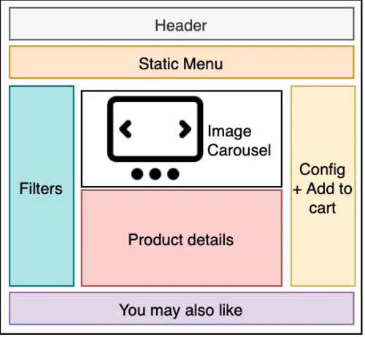
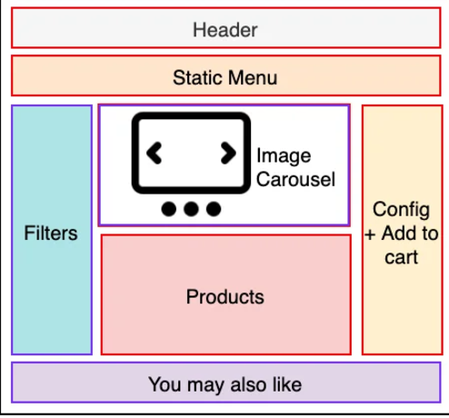
Visual Comparison between architectures
SSR
Progressive Hydration
Islands Architecture
Render all components, hydrate key components first and then progressively hydrate others
Static components are server rendered HTML. Script is only required for interactive components
Render all components together and hydrate
https://www.patterns.dev/vanilla/islands-architecture/

Slide 29
Summary Execution Table
Rendering Technique | Build Time | Run Time (Server) | Run Time (Client)
Static Site Generation (SSG) | ✅ | ❌ | ❌
Incremental Static Site Generation (ISG) | ✅ (initial) | ✅ (on-demand updates) | ❌
Server-Side Rendering (SSR) | ❌ | ✅ | ✅ (for hydration only)
React Server Components (RSC) | ❌ | ✅ | ❌ (for server components only)
Client-Side Rendering (CSR) | ❌ | ❌ | ✅ (hydration of islands)
Islands Architecture (Astro) | ✅ (static parts) | ❌ (for static parts) ✅ (dynamic parts) | ✅
Resumability (Qwik) | ✅ | ❌ | ✅(resume interactivity only)

Slide 30
The Future of Web Rendering Architectures (Part 1)
Streaming SSR: Sends HTML to the client in chunks from the server
Edge-rendering: Distributed, faster content delivery via edge servers, reducing latency by serving content from global locations (e.g. Cloudflare Workers)
  Use Case : Global apps with fast content delivery
Serverless Rendering: Serverless functions, removing the need for dedicated servers and dynamically scaling resources. Reduces overhead. Optimize cost.
  Use Case: Scalable apps with fluctuating traffic demands
Notes:
Hybrid Approaches: React Server Components will influence the future of web rendering, allowing developers to split
Server-rendered and client-rendered parts of the app. Server will do the computation heavy, while clien
will focus on the dynamic and interactive parts
Web Assembly: Will be needed for computational-heavy tasks such as Games, Simulations, Image/Video processing.
It will enable languages like Go/Rust/C++ to run in a near-native performance in the browser
Edge Rendering: Edge Computing will grow in importance as more applications are moving from centralized servers to
distributed network of servers close to the user. This enable faster load times, better SEO & performance.
Frontend role: Optimize for content-caching strategies, assets pre-rendered or delivered from the nearest server
Serverless-Side Rendering: https://www.webiny.com/blog/serverless-side-rendering-e1c0924b8da1
Real-time Rendering: Real time applications like chat, gaming, collaborative tools will continue pushing the boundaries of web
rendering. Technologies like WebSockets and WebRTC enable low-latency, two-way communication
between client and server.

Slide 31
The Future of Web Rendering Architectures (Part 2)
Web Assembly: High Performance client-side processing at near-native speed (e.g. Rust)
  Use cases: Games, simulations, Image Video Processing, CAD Applications for 3D Rendering, TensorFlow, complex web design tool (Figma)
Real-time Rendering: Immediate content updates where systems responds to user interactions
  Use cases: Live collaboration tools, chat applications, live updates
Notes:
Hybrid Approaches: React Server Components will influence the future of web rendering, allowing developers to split
Server-rendered and client-rendered parts of the app. Server will do the computation heavy, while clien
will focus on the dynamic and interactive parts
Web Assembly: Will be needed for computational-heavy tasks such as Games, Simulations, Image/Video processing.
It will enable languages like Go/Rust/C++ to run in a near-native performance in the browser
Edge Rendering: Edge Computing will grow in importance as more applications are moving from centralized servers to
distributed network of servers close to the user. This enable faster load times, better SEO & performance.
Frontend role: Optimize for content-caching strategies, assets pre-rendered or delivered from the nearest server
Serverless-Side Rendering: https://www.webiny.com/blog/serverless-side-rendering-e1c0924b8da1
Real-time Rendering: Real time applications like chat, gaming, collaborative tools will continue pushing the boundaries of web
rendering. Technologies like WebSockets and WebRTC enable low-latency, two-way communication
between client and server.

Slide 32


Thank you!
<Connect with me>
tech.evangelia.me
contact@evangelia.me

